Slide 1
JUSTICE

Slide 2
From a linguistic point of view, justice means and is related to:
legal
right
fair
rightness
impartiality
law
equity

Slide 3
Symbolic representation, adopted from Greek mythology:
The Goddess Themis and her symbols
Themis symbolises “the law of nature” and was considered the personification of the Divine order.
Her eyes tied mean justice should be done with impartiality
The balance means all the evidence is weighed and shows in conditions of impartiality where justice is
The sword means the execution of what is decided after an impartial judgment

Slide 4
We chosed to speak about racism because we feel and think that humans are all alike, and because racism still exists and it is unjust
We chosed to speak about freedom because we feel and think that humans are born to be free, and that’s right
We chosed to speak about equality because we feel and think that humans are born to be equal one to another and every human being is right to regard others as equal to him.
Question : did we chose from a rational point of view or from an emotional point of view ?
Answer : both
Consequence : relativity of perceptions, decisions, relativity of almost everything because our emotional background and because our different level of knowledge.

Slide 5
Why do we consider JUSTICE a very important value ?
First of all we can see that justice implies the respect of all other values.
Some answers to our question :
All humans should be equal in front of law
We feel and think about everything around us, in terms of right or wrong
We use the word justice in connection with any event or action PRODUCED BY HUMAN BEINGS.
As Themis represents, we humans feel in a very profound and subconscious way, what is right and what is wrong. This is our a 6’th sense.

Slide 6
Let’s observe types of social injustice represented by the following photos.
Please define what is not right, what is not fair in each photography.
Please find a right, fair, nice counterbalancing term or idea.

Slide 7
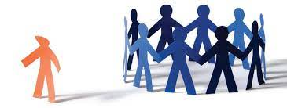
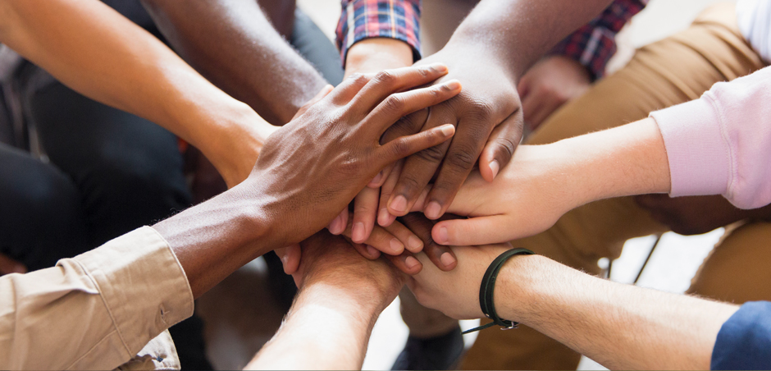
Social injustice in the world :
Discrimination
Opposite:

Slide 8
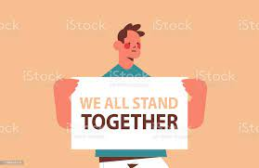
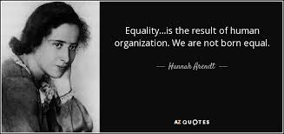
Social injustice in the world :
Inequality
Oposite:

Slide 9
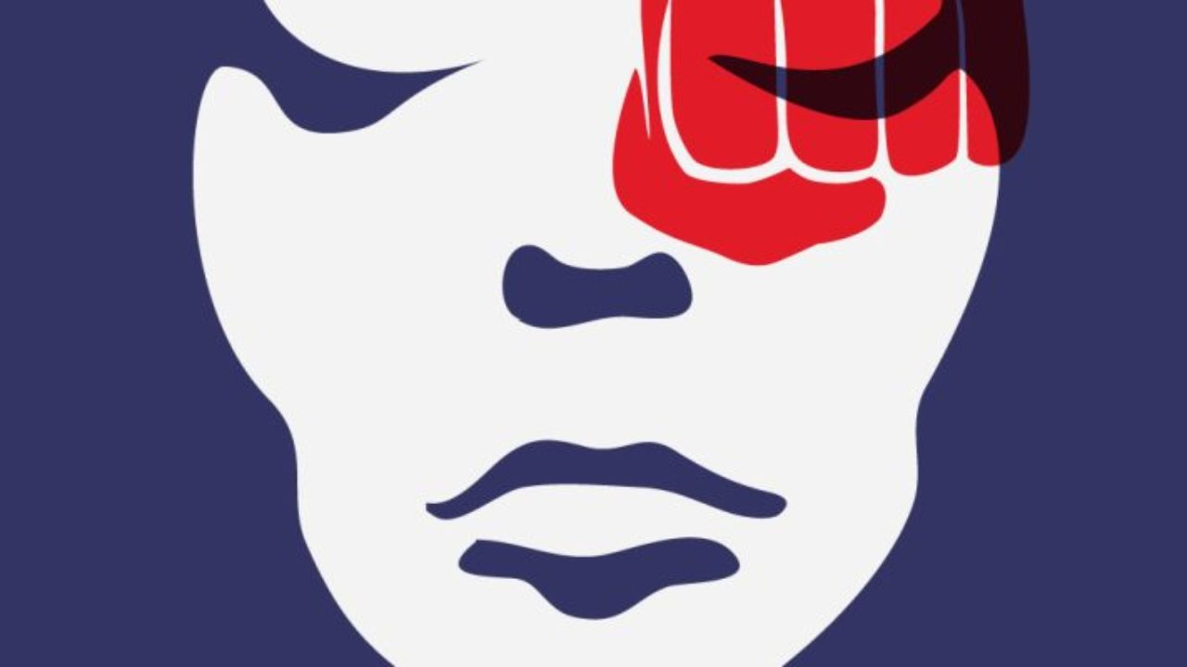
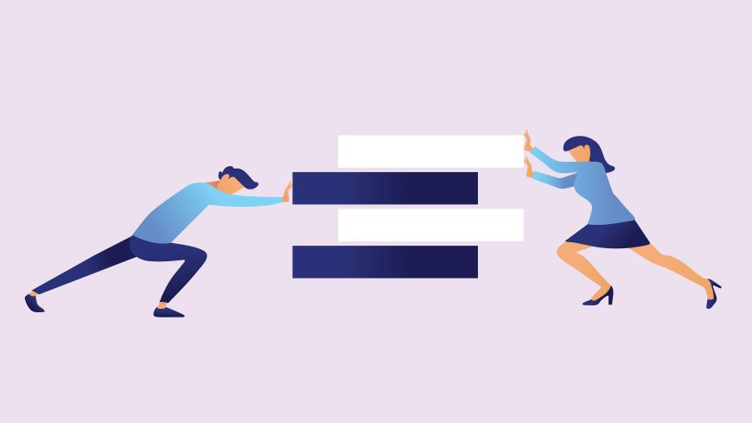
Social injustice in the world:
Gender-based violence
Opposite :

Slide 10
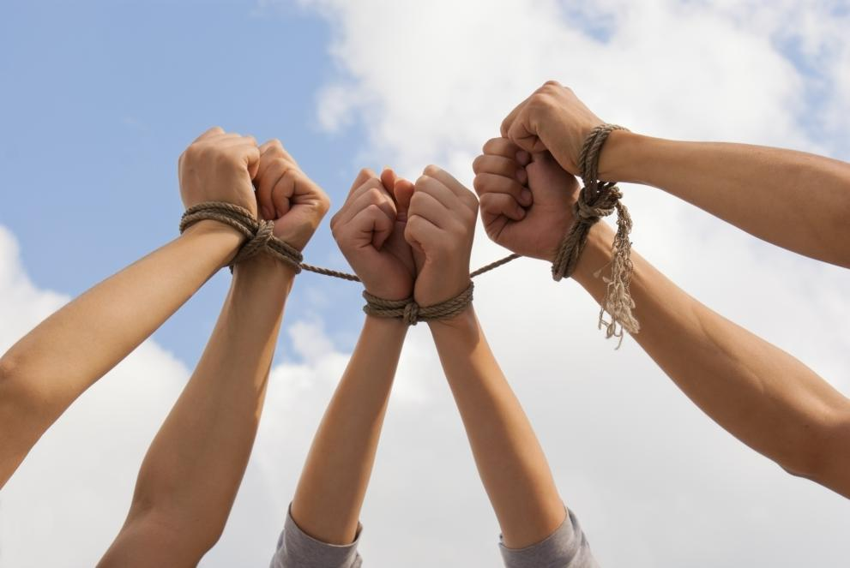
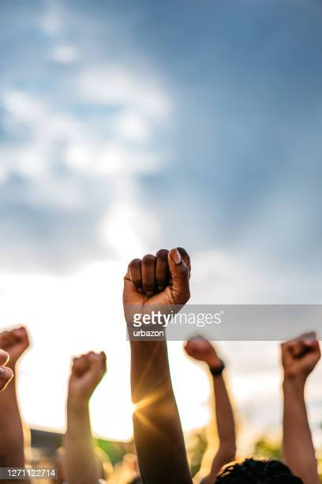
Social injustice in the world:
Human trafficking
Opposite :

Slide 11
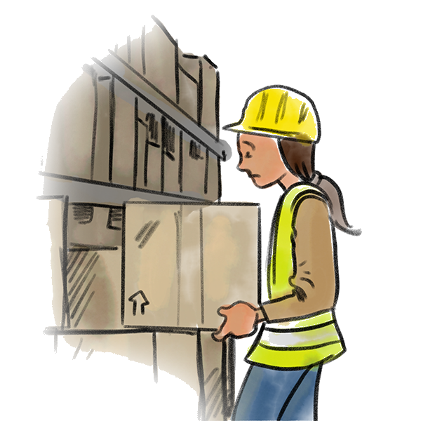
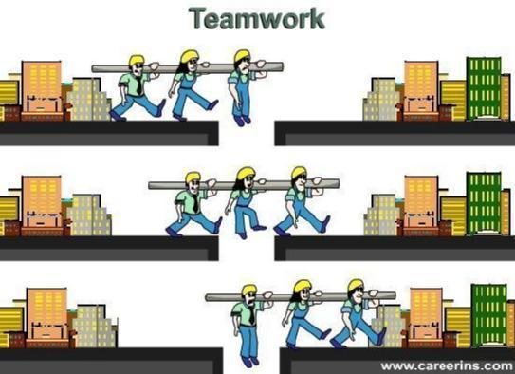
Social injustice in the world:
Labor exploitation
Opposite

Slide 12
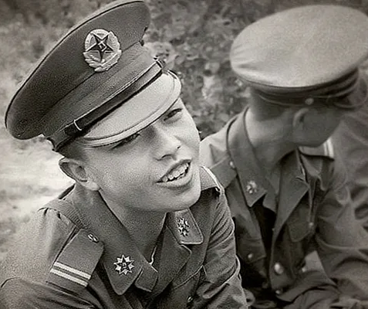
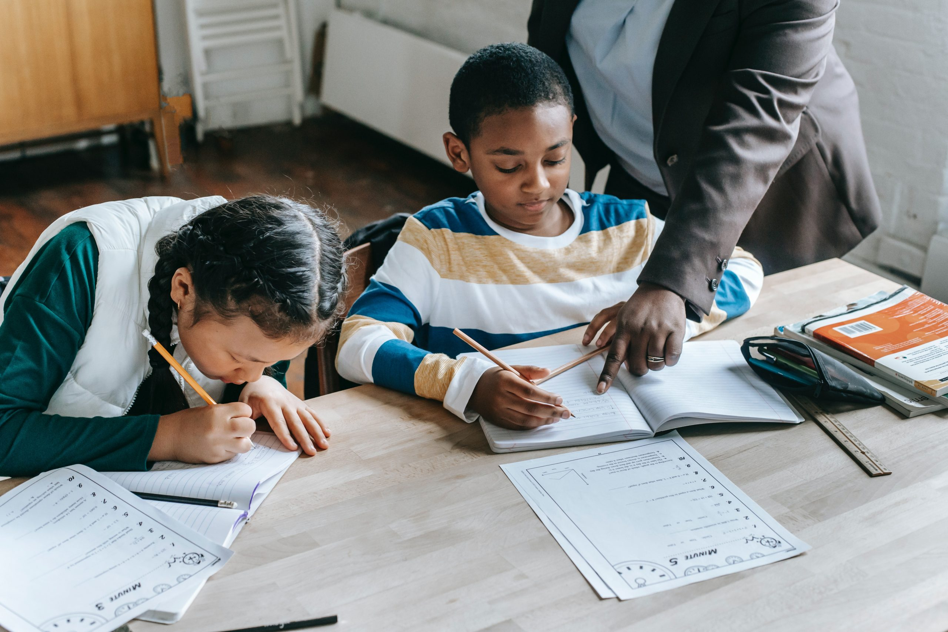
Social injustice in the world
Military use of children
Opposite :

Slide 13
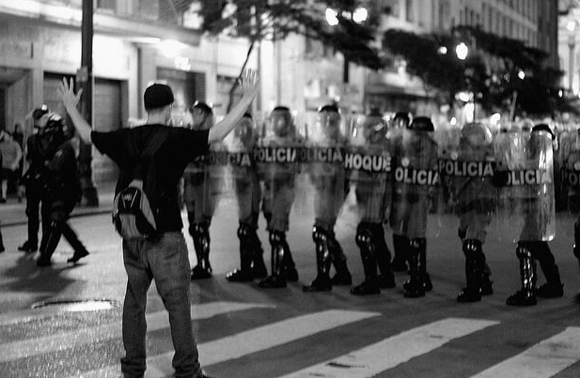
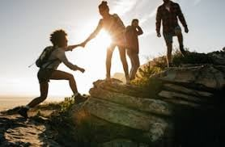
Social injustice in the world:
Violation of human rights
Opposite :

Slide 14
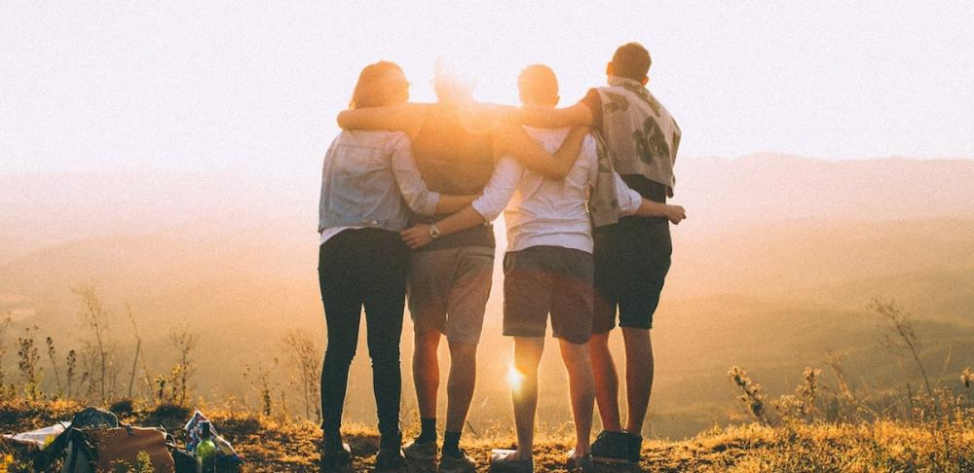
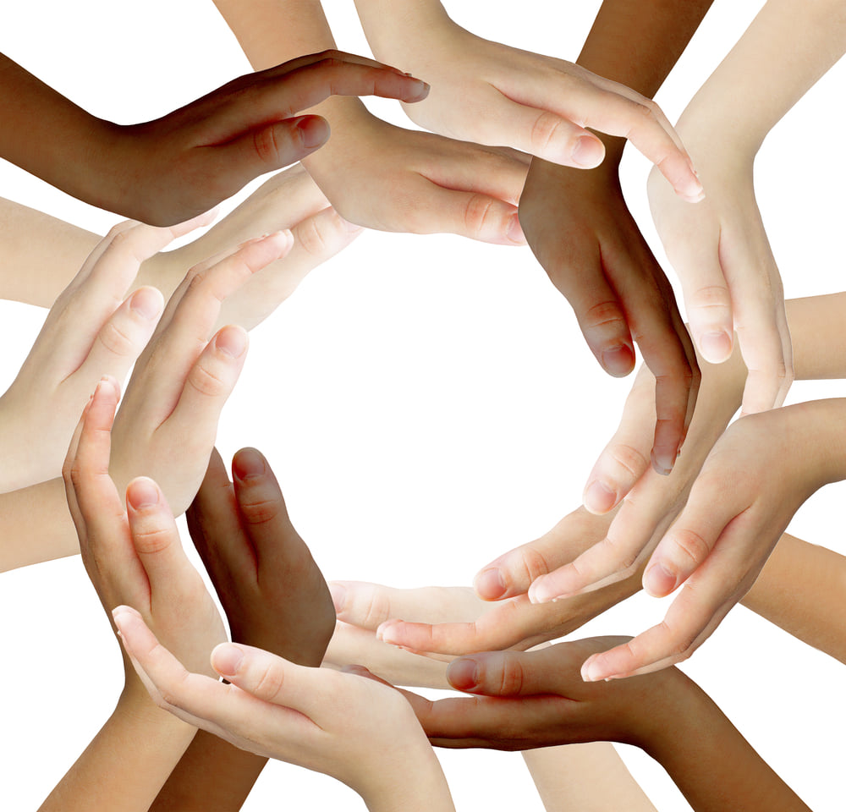
Thank you

